Slide 1
Analyzing & Visualizing
Regional Sales Performance
Year
Discount
Month
Profit
Sales
Products
Using Microsoft Excel
- Sangeetha Gunasekaran

Slide 2
CONTENTS
01. Searching and Filtering Data
02. Data Cleaning with Text Functions
03. Merging Data
04. Excel Formulas
05. Pivot Tables
06. Charts
07. Regression Analysis
08. Stacked Bar Chart
09. Basic Dashboard
10. Highlight High Performers (Conditional Formatting)

Slide 3
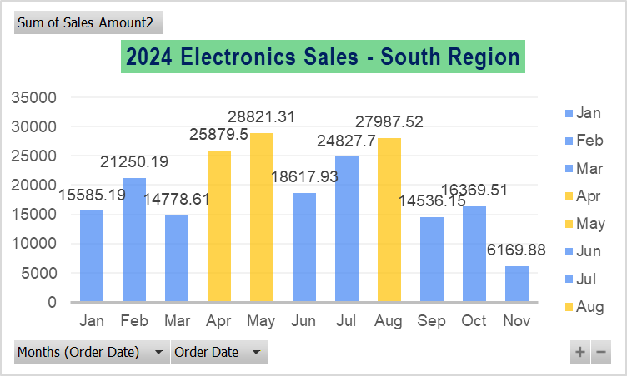
Searching & Filtering Data
Used Filters to filter Electronics sales happened in 2024 for South region
Used Pivot table & grouped order date to show month-wise 2024 sales.
Summed up Sales and placed month, year data in rows to get month wise total Electronics sales data for 2024 in South region
Selected the Pivot result and inserted bar chart to visualize the trend.
Highlighted top 3 performing months of South in Electronics (April, May & August).

Slide 4
2. Data Cleaning with Text Functions
Used PROPER, TRIM & CLEAN functions to clean & Standardize the Region and Product Category columns.
Instead of normal SUBSTITUTE function for replacing special characters one by one, used POWER QUERY EDITOR to remove all special characters in one go.
Formula used in Power query Editor
Text.Select([YourColumnName],List.Combine({{"A".."Z"},{"a".."z"},{" "}}))
As a last step, Used FIND & REPLACE operations to replace some uncleanable data.
Order ID - As Order IDs are identifiers, not values have changed Datatype to Text
Order Date - Confirmed if the date is stored as a number using ISNUMBER(),YEAR() FUNCTION, Chose yyyy-mm-dd custom format for better visuals

Slide 5
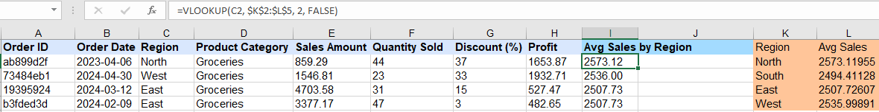
3. Merging Data
Used “=AVERAGEIF(C:C, K2, E:E)” function to make Average Sales Summary Table based on regions
Merged the above calculated Regional Total Average Sales value back into the dataset using “=VLOOKUP(C2, $K$2:$L$5, 2, FALSE)” function

Slide 6
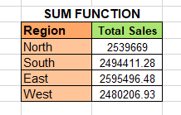

4. Excel Formulas
AVERAGE FUNCTION:
Filtered Product Category to Furniture.
Calculated the average discount percentage and average profit for the "Furniture" category using AVERAGE formula.
SUM FUNCTION:
Have used SUMIF formula to Sum the region wise total sales

Slide 7
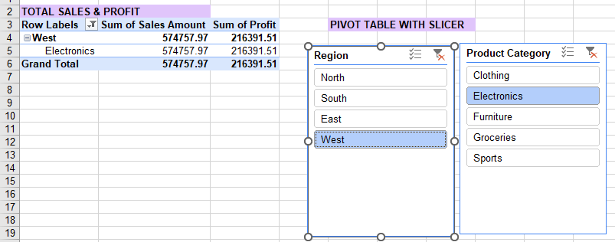
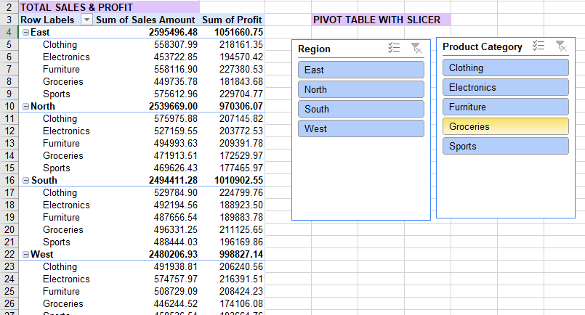
5. Pivot Table
Pivot Table: Summarizes and analyzes large data quickly.
Slicer: Provides an easy way to filter and view specific data in a pivot table.

Slide 8
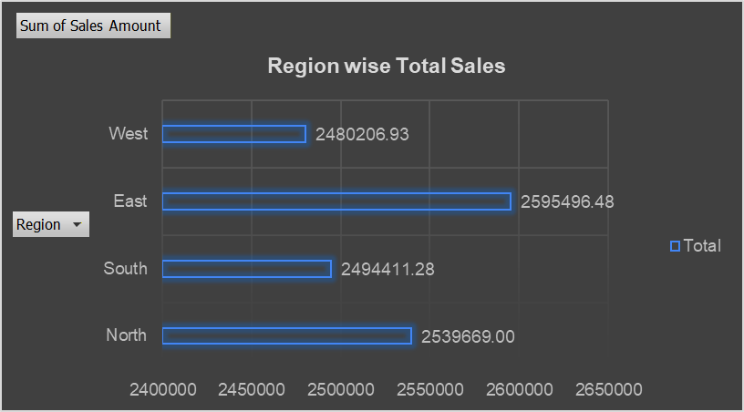
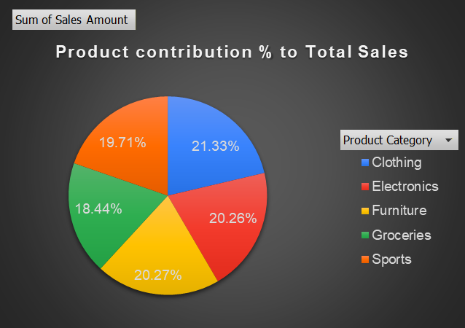
6. Charts
Bar Chart: Used Pivot table to calculate the Total Sales of each region. Inserted Bar chart to show the highest to lowest performing regions.
Pie Chart: Used Pivot table to 1st calculate the Total Sales of individual product Categories. From the results calculated the individual percentages by changing the Value Field Settings to %. Inserted Pie chart to visualize the % contribution
Inference: High performing region - East, product Category - Clothing

Slide 9
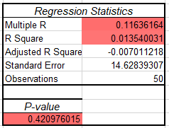
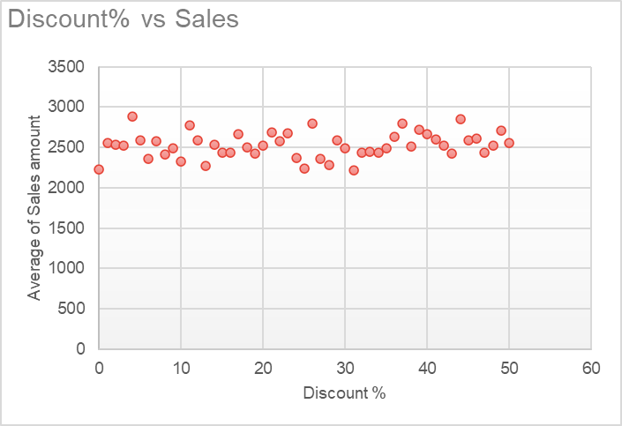
7. Regression Analysis
To Insert scatter chart, Used Pivot table to form a new column with Average sales calculation.
Performed Regression analysis to further study how one variable affects the other variable.
Final Take Away:Indices were weak. Indicated no strong linear relationship therefore discounts do not strongly drive sales.
Notes:
“We use average sales instead of total sales because total sales would give just one point per group, making the scatter plot meaningless, whereas average sales preserves variation across categories, making patterns and comparisons visible.”

Slide 10
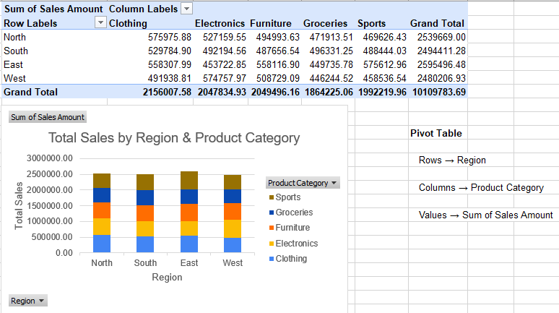
8. Stacked Bar Chart
Overall Sales Distribution:
The East region has the highest total sales (≈ ₹25.95 lakh), closely followed by North and South, while West is slightly lower.
Category-wise Contribution:
Clothing is the largest contributors across most regions. Furniture and Electronics are moderately contributing.Groceries have the lowest contribution in all regions.

Slide 11
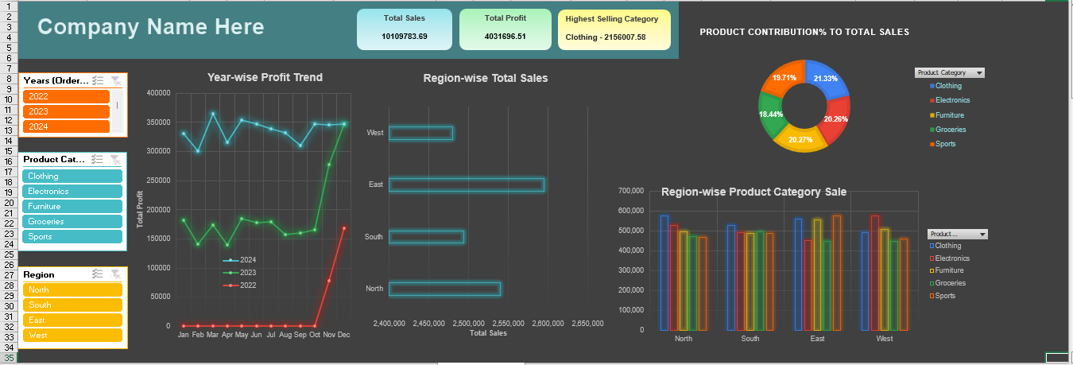
9. Dashboard
Used 4 different charts(line,bar,clustered column, donut) using same pivot data to showcase the key metrics.
Created 3 slicers - for year, product category, Regions. Connected all the charts through slicers for dynamic filtering
Used formulas to make KPIs interactive to reflect the current highest value. Eg:If the value of Furniture gets high, Highest Selling category changes from Clothing to Furniture, also showing the respective value.

Slide 12
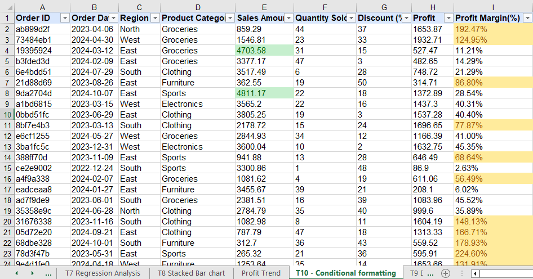
10.Conditional Formatting
A Profit Margin (%) column was derived from Profit / Sales Amount and conditional formatting was used to highlight high-value sales (Sales > ₹4,000) and high-profit transactions (Profit Margin > 50%) for quick performance identification.

